Slide 1
A Project Presentation on Online PCMart Group no: 24 Enrollment Nos :24034211046 24034211001

Slide 2
INTRODUCTION
The Online PCMart helps users design and assemble custom PCs based on their needs and budget.
prebuild pc are present can also be customized.
The system makes PC building simple, accurate, and beginner-friendly.
*
24- Online PCMart

Slide 3
1.1 Project Profile
Project Title | Online PCMart
Objectives | To provide an online platform where users can build customized PCs, choose from prebuilt options, filter by budget/use, save builds, add to cart, and purchase online.
Frontend | React, HTML, CSS, JavaScript
Backend | Spring Boot
Others | Data source: MySQL (Database), Json Testing: postman
Group No | 24
Enrollment No. | 24034211046, 24034211001
Names of partners | PATEL ARYA, ACHARYA DHUN
Company Name | N/A
Company Address | N/A
External Guide | N/A
Internal Guide | MS. Aruna Gurjar
24- Online PCMart

Slide 4
1.2 About the System
Online PCMart is a PC building System.
Provides custom-built PCs and prebuilt systems.
Categories: Gaming, Professional, Basic PCs.
Budget range filtering for easier selection.
Focus on transparency, reliability, and flexibility.
Aim: Simplify the process of buying a PC.
24- Online PCMart

Slide 5
SYSTEM STUDY AND ANALYSIS
*
24- Online PCMart

Slide 6
2.1 Problem Statement
Customers face difficulty selecting compatible PC parts.
Existing platforms (Amazon, Flipkart, local shops) lack an integrated PC builder tool.
No option to save custom builds for later use or modifications.
Lack of transparency in pricing and component details.
*
24- Online PCMart

Slide 7
2.2 Existing System
Offline Shops
Customers depend on vendor recommendations.
Limited stock availability and fewer customization options.
Pricing often lacks transparency.
E-commerce Platforms (Amazon, Flipkart, etc.)
Users can buy individual components or prebuilt PCs.
No integrated system to check compatibility between selected parts.
No option to save and reuse builds.
Prebuilt PCs are generic, not categorized by usage or budget.
24- Online PCMart
*

Slide 8
2.2.1 Drawbacks
Limited customization – customers cannot freely build PCs.
No save feature for custom builds.
Vendor dependency in offline shops ,lack of transparency in pricing.
Generic prebuilt PCs online, not categorized by usage or budget.
*
24- Online PCMart

Slide 9
2.3 Proposed System
An Online PCMart platform for customized builds.
Users can select compatible components with automated checks.
Option to save builds and purchase later.
Prebuilt PCs categorized by usage (Gaming, Professional, Basic) and budget range.
Integrated cart and checkout system for smooth online purchases.
Admin dashboard to manage components, inventory, and prebuilt systems.
*
24- Online PCMart

Slide 10
2.3.1 Advantages or Comparison Study
Compatibility check ensures error-free builds (not available in existing platforms).
Users can save and modify builds, unlike Amazon/Flipkart.
Filtered prebuilt PCs (Gaming, Professional, Basic) help quick decisions.
Budget-based selection provides affordability options.
Transparency in pricing and clear component details.
All-in-one solution – build, compare, save, and buy in one place.
*
24- Online PCMart

Slide 11
2.3.2 Modules (with short description)
User Module Allows users to register, log in, and manage their profiles.
PC Builder Module Provides options to select components, check compatibility, and build custom
PCs.
Prebuilt PC Module Displays ready-to-purchase PCs categorized as Gaming, Professional,
and Basic.
Cart and Checkout Module Let’s users add selected builds or prebuilts to the cart and proceed to purchase.
Save Build Module Enables users to save customized builds for future reference or editing.
Admin Module Manages products, categories, pricing, and monitors user orders.
*
24- Online PCMart

Slide 12
3.1 Hardware Requirement
Component | Client Side Requirement | Server Side Requirement
Processor | Intel i3 10th Gen / AMD Ryzen 3 | Intel i5 10th Gen or above
RAM | 512 MB | 8 GB or higher
Storage | (Browser only) | 512 GB SSD or higher
Operating System | Windows 10 / Linux / macOs | Windows 11 / Latest Linux Distro
Internet | Basic Broadband | High-Speed Broadband
24- Online PCMart

Slide 13
3.2 Software Requirement
Software | Purpose
Windows / Linux | Operating System
MySQL | Database Management
Spring Boot | Backend Framework
Maven | Dependency Management
Browser (Chrome,FireFox, Edge) | For running and testing frontend
VS Code / IntelliJ | Development Environment
24- Online PCMart

Slide 14
3.3 Programming Environment

Slide 15
3.3.1 About Front-End
Technology | Usage
HTML | Structure of web pages
CSS | Styling and layout
JavaScript | Dynamic and interactive UI
24- Online PCMart

Slide 16
3.3.2 About Back-End
Technology | Usage
Spring Boot | Server-side logic and APIs
MySQL | Database for storing application data
REST APIs | Communication between frontend & backend
Maven | Build automation and dependency management
24- Online PCMart

Slide 17
3.4 DEVELOPMENT ENVIRONMENT
*
24- Online PCMart

Slide 18
SYSTEM DESIGN AND DEVELOPMENT
*
24- Online PCMart

Slide 19
Input Design (Frontend)
Login → Username/Email, Password
Registration → Username, Email, Password, Confirm Password, OTP,
Profile Picture
Forgot Password → Email, OTP, New Password, Confirm Password
Account Management → Change Username, Upload/Delete Profile Picture
PC Builder → Select CPU, GPU, RAM, Storage, Cabinet, OS, Add to Cart
Prebuilt PCs → Filter by Usage (Gaming, Office, Dev) & Price (Budget/Mid/High)
Contact Us → Name, Email, Message
Other Inputs → Theme Toggle (Dark/Light), Navigation Menu

Slide 20
Input Design (Backend & Database)
Backend API Inputs:
/login → { username/email, password }
/logout → End user session
/request-otp, /verify-otp, /reset-password
/request-otp-register, /verify-otp-register
/userId/profile-picture → Upload/Delete file
/userId/username → { newUsername }

Slide 21
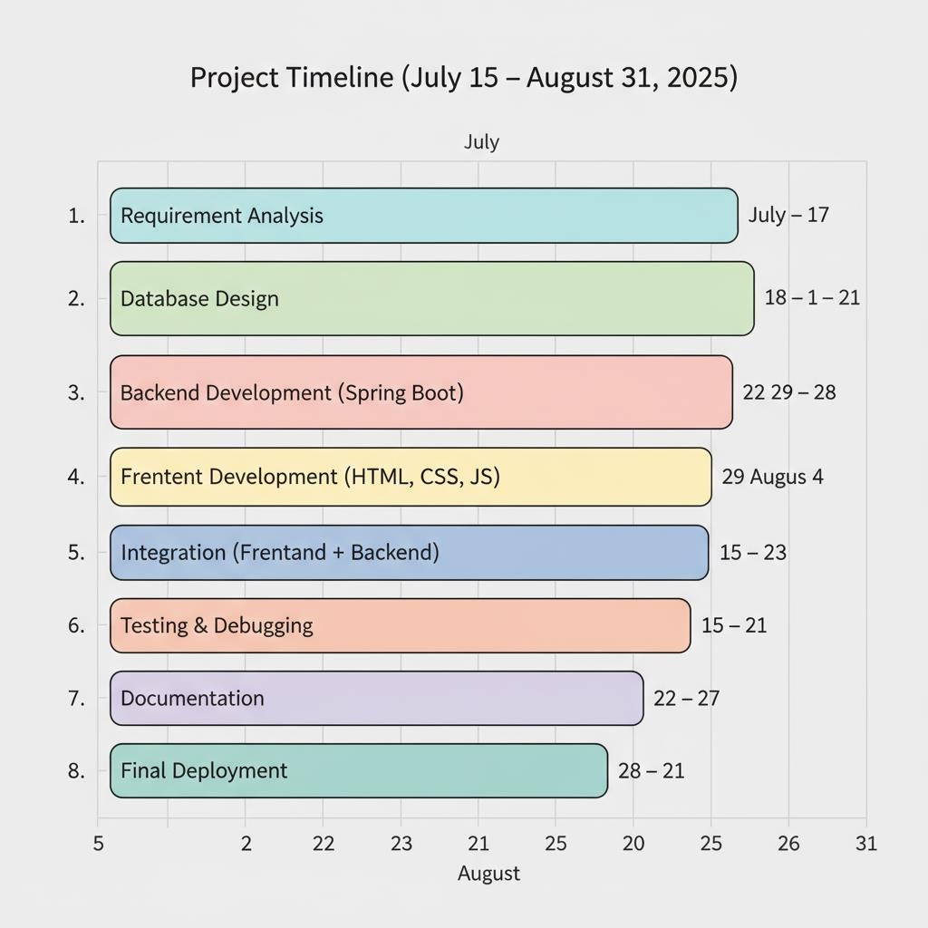
Time-line chart

Slide 22
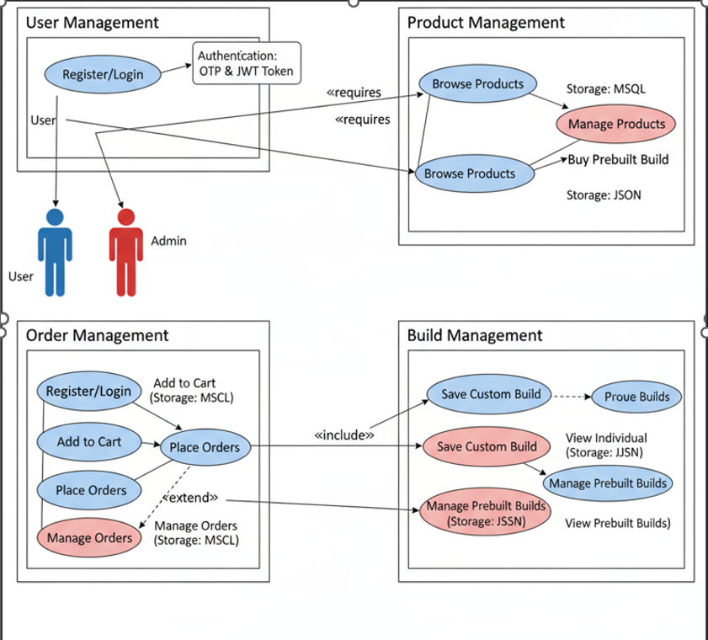
Use-case Diagram

Slide 23
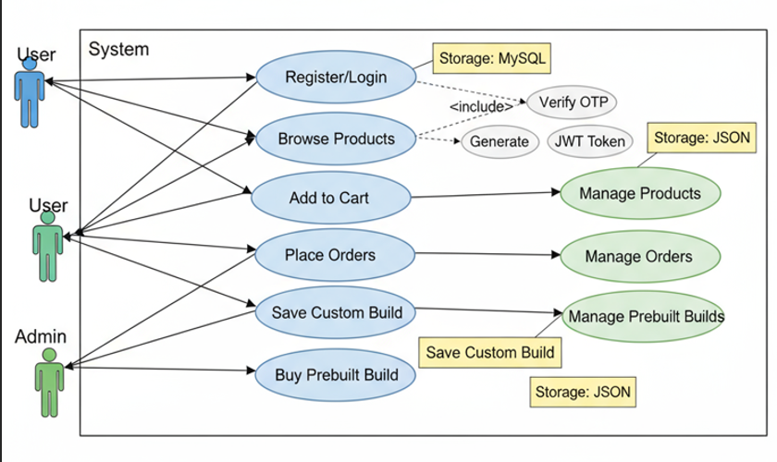

Slide 24
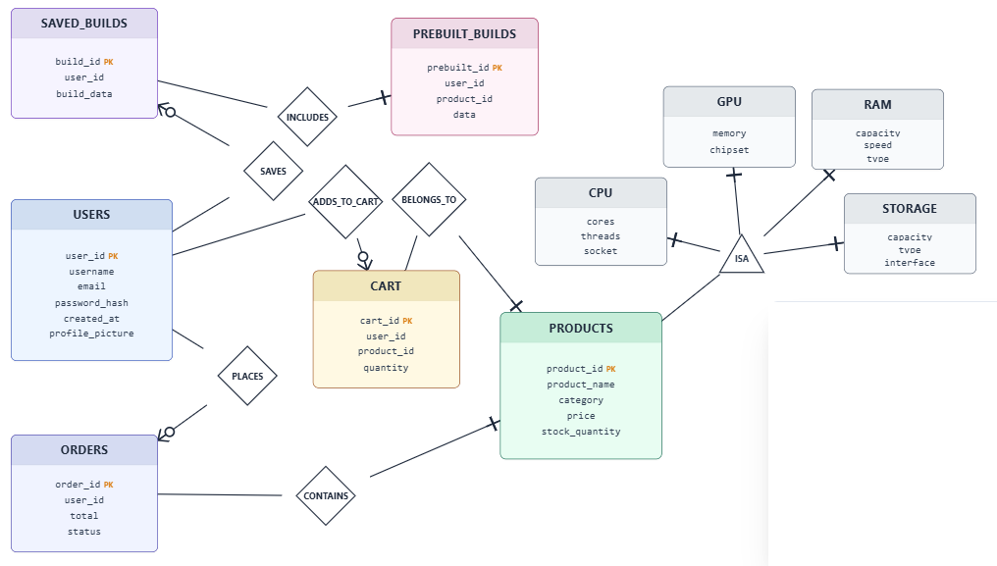
E-R Diagram

Slide 25
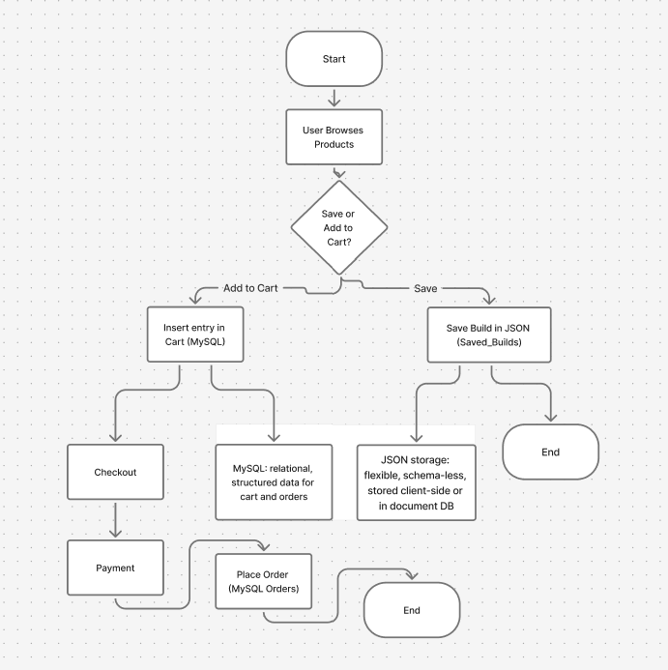
Activity Diagram

Slide 26
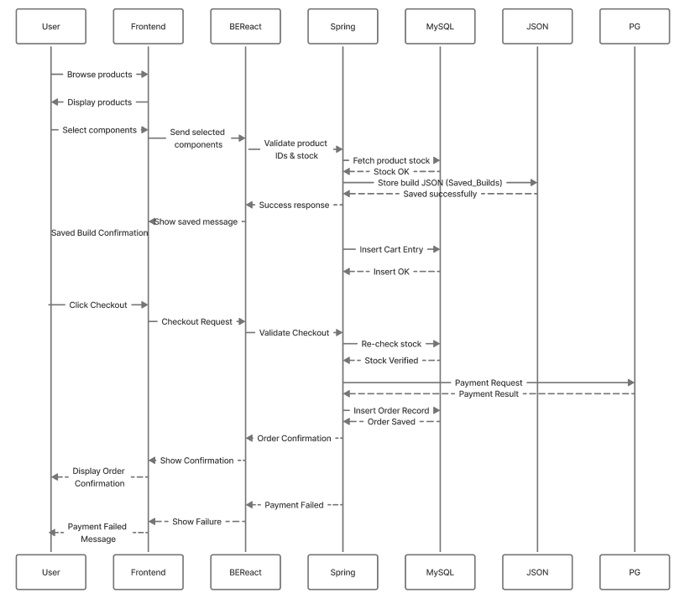
Sequence Diagram

Slide 27
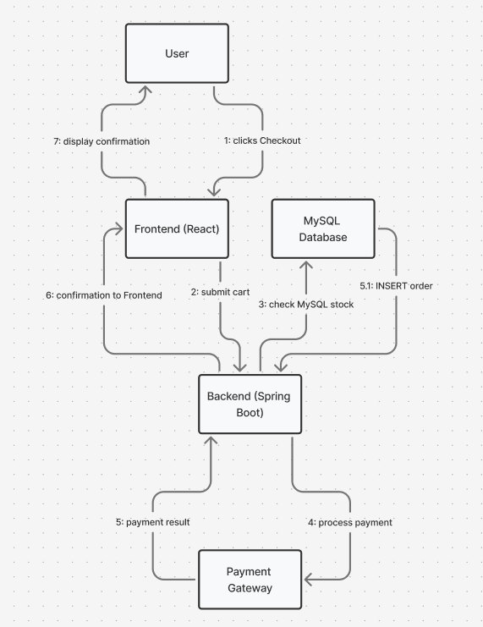
Collaboration Diagram

Slide 28
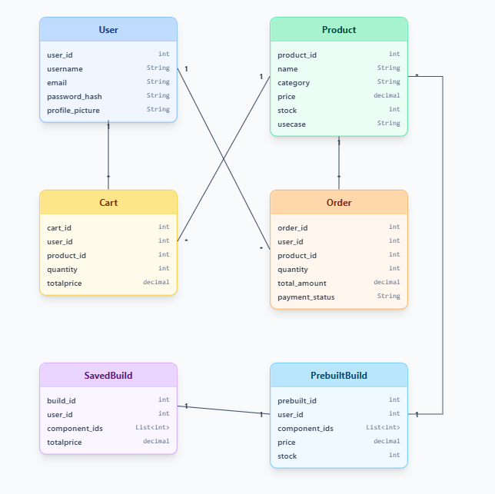
Class Diagram

Slide 29
Database Inputs (users table):
id → Auto-generated unique identifier
username → Unique string
email → Unique string
password → Encrypted string
date_ → Account creation timestamp
otp → One-time password for verification
otp_expiry → OTP expiry timestamp
expiry → Login session expiry timestamp
role → Default “USER”
profile_picture → File path string

Slide 30
Output Design (Frontend)
Success Messages → “Login Successful”, “User Registered Successfully”
Error Messages → “Invalid Password”, “OTP Expired”, “Email Already Registered”
OTP Status → Sent, Verified, or Expired
Profile Picture Preview → Display after upload/crop
PC Build Summary → Selected components with total price
Prebuilt PCs → Filtered list by usage/price
Account Dashboard → Saved builds, cart items, orders
Contact Us Form → Success/Failure response

Slide 31
Output Design (Backend & Database)
Backend API Responses:
Login → { token, expiry, username, userId, prof_pict }
OTP Request → “OTP sent to registered email”
OTP Verification → “OTP verified, you can reset password”
Registration → “User registered successfully”
Password Reset → “Password reset successful”
Profile Picture → { message, profile_picture_url }
Change Username → { message, username, token, expiry }
Error Responses → e.g., 400 Bad Request, 401 Unauthorized

Slide 32
Database Updates:
id → Auto-generated when user registers
username → Updated if changed
email → Retrieved during login/OTP
password → Stored as encrypted string
otp / otp_expiry → Temporary, cleared after verification
expiry → Updated on login (10-day session)
profile_picture → Stores uploaded file path, null if deleted

Slide 33
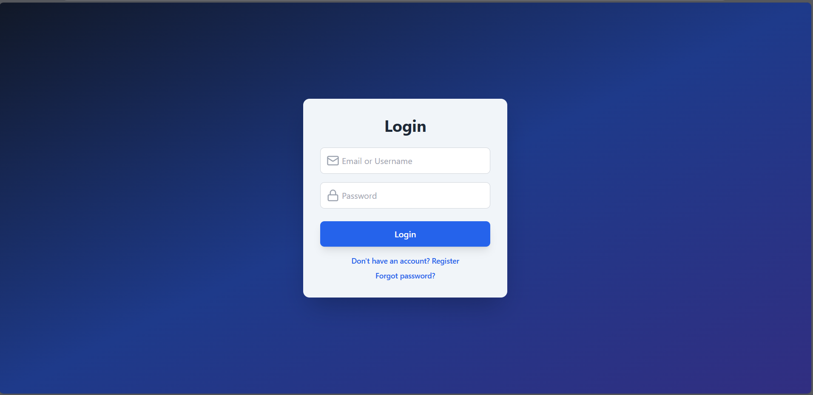
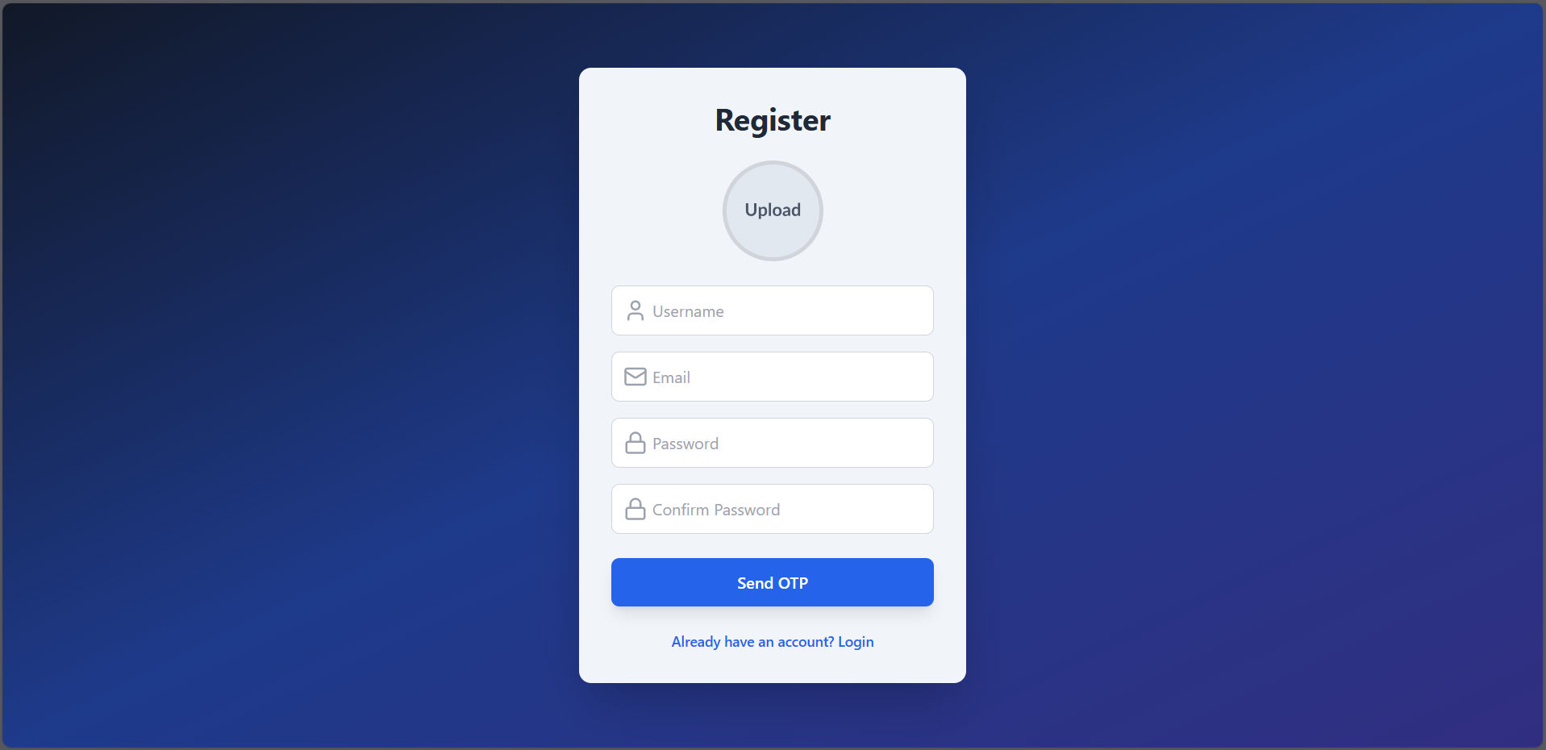
Login and Registration screen

Slide 34
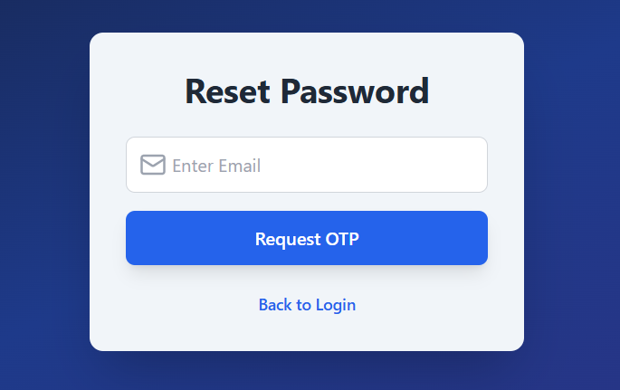
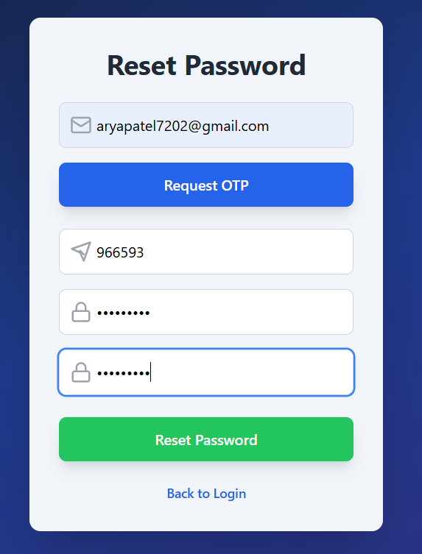
Forgot Password

Slide 35
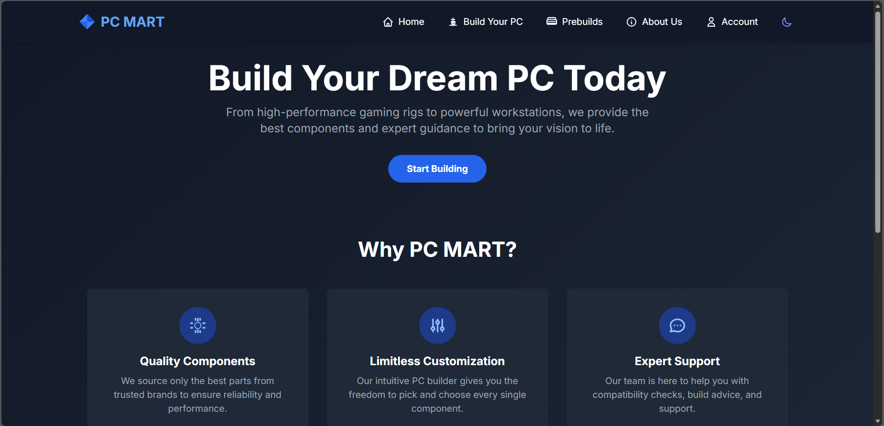
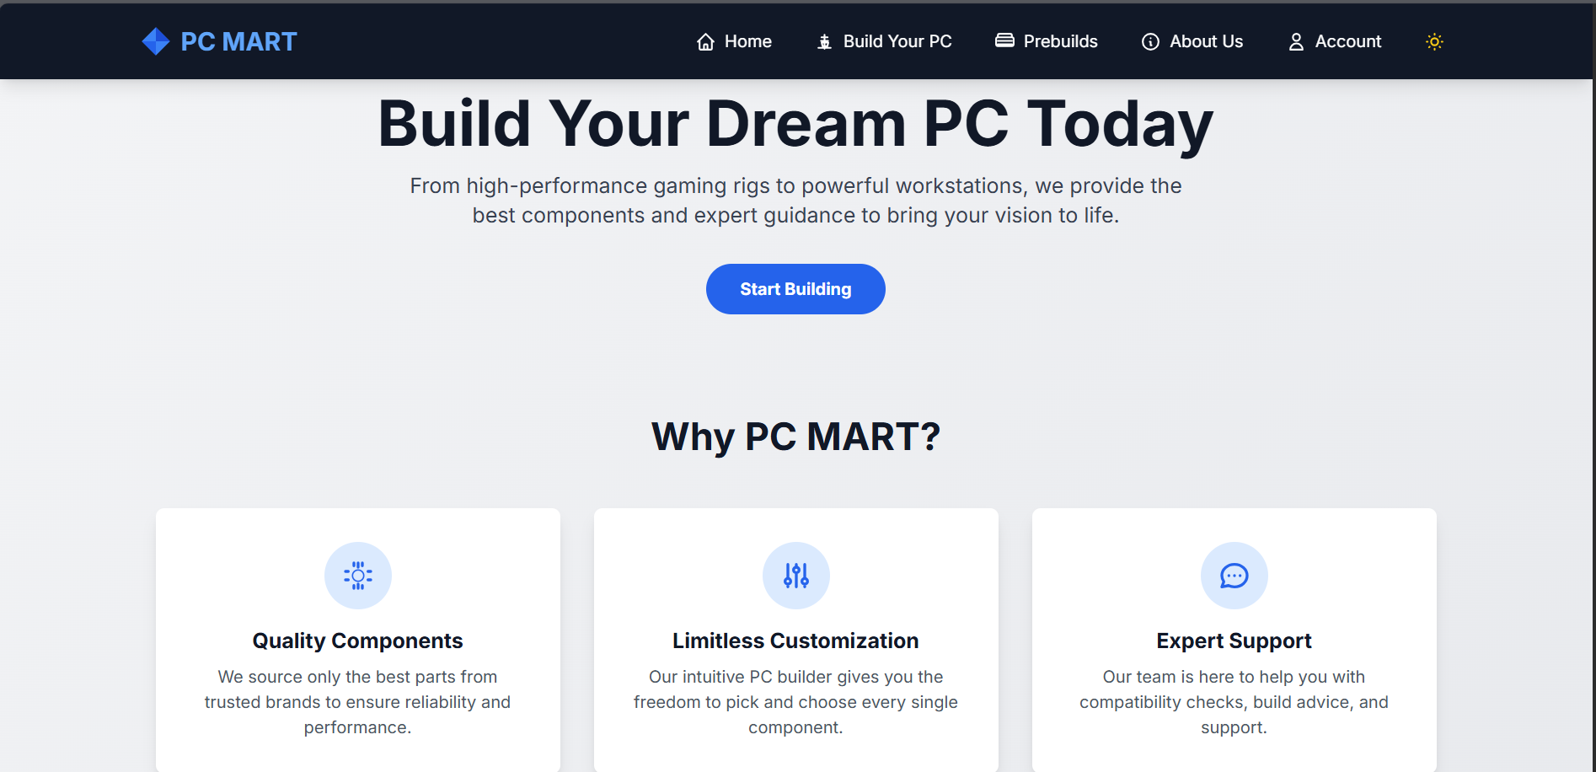
Home Page

Slide 36
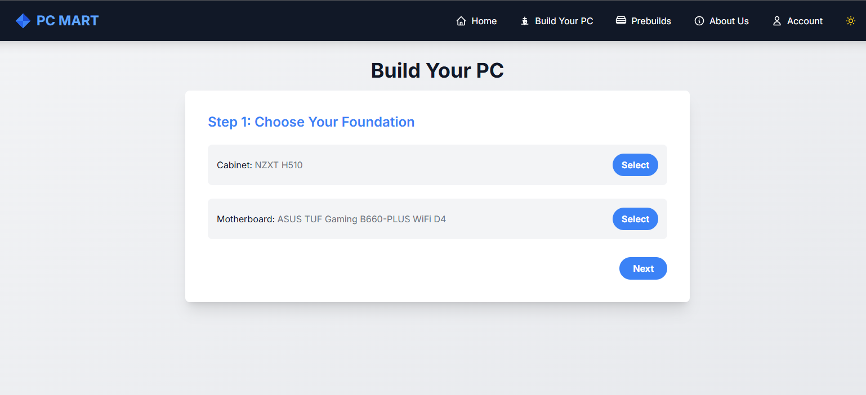
Build Your Own Pc

Slide 37
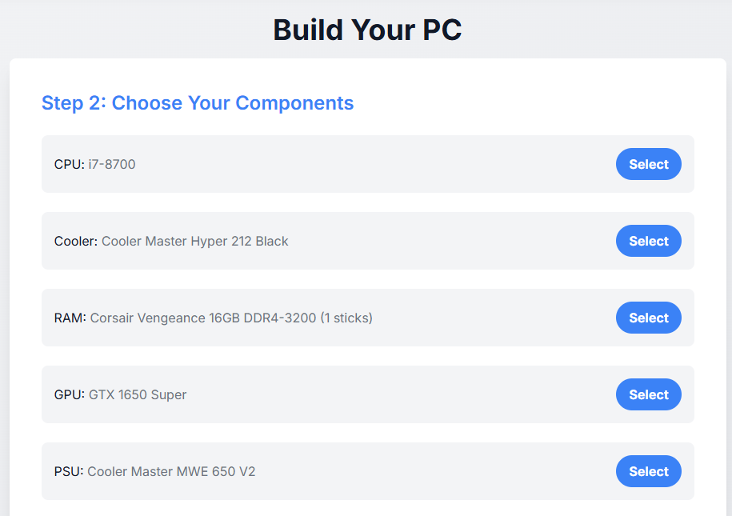

Slide 38
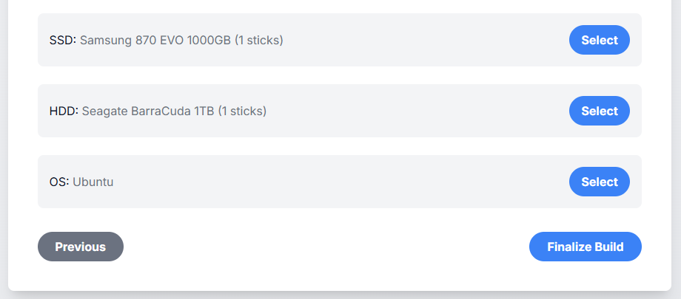

Slide 39
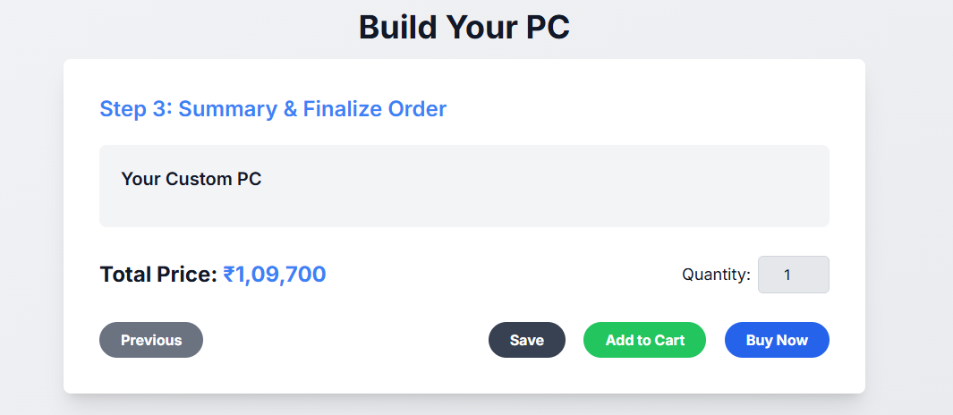

Slide 40
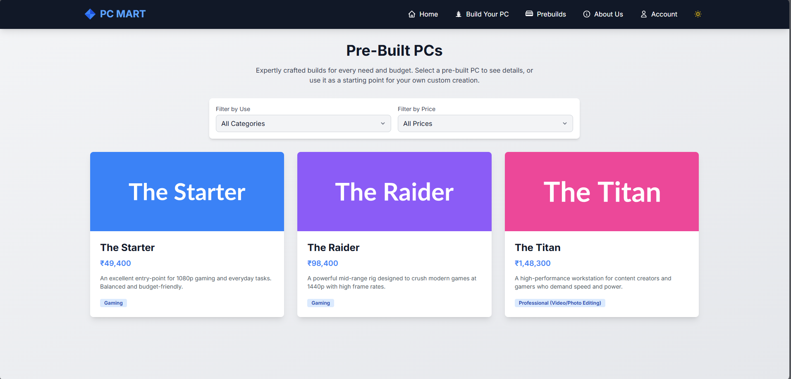
PreBuild

Slide 41
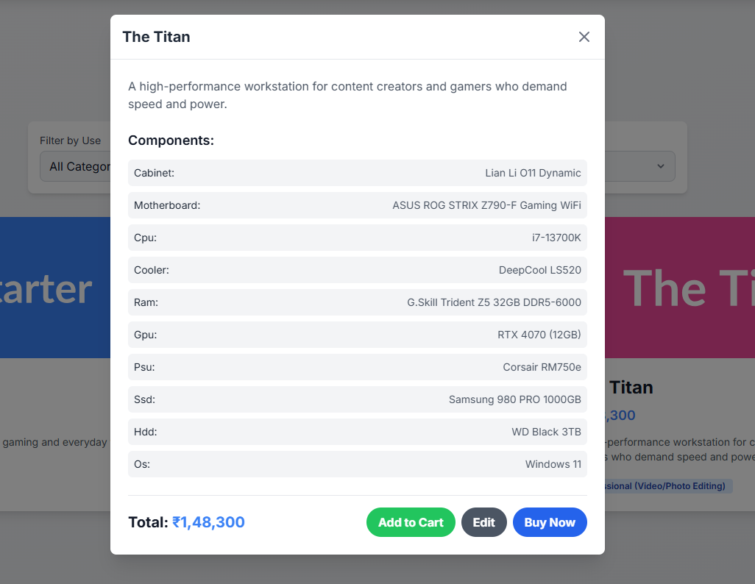

Slide 42
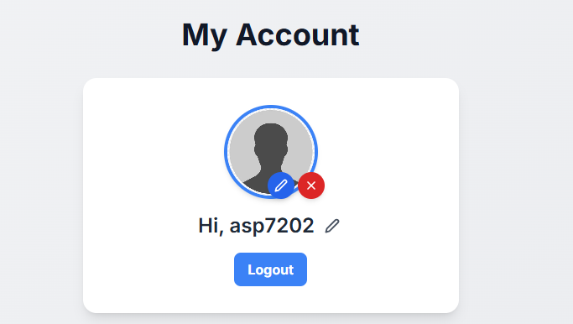
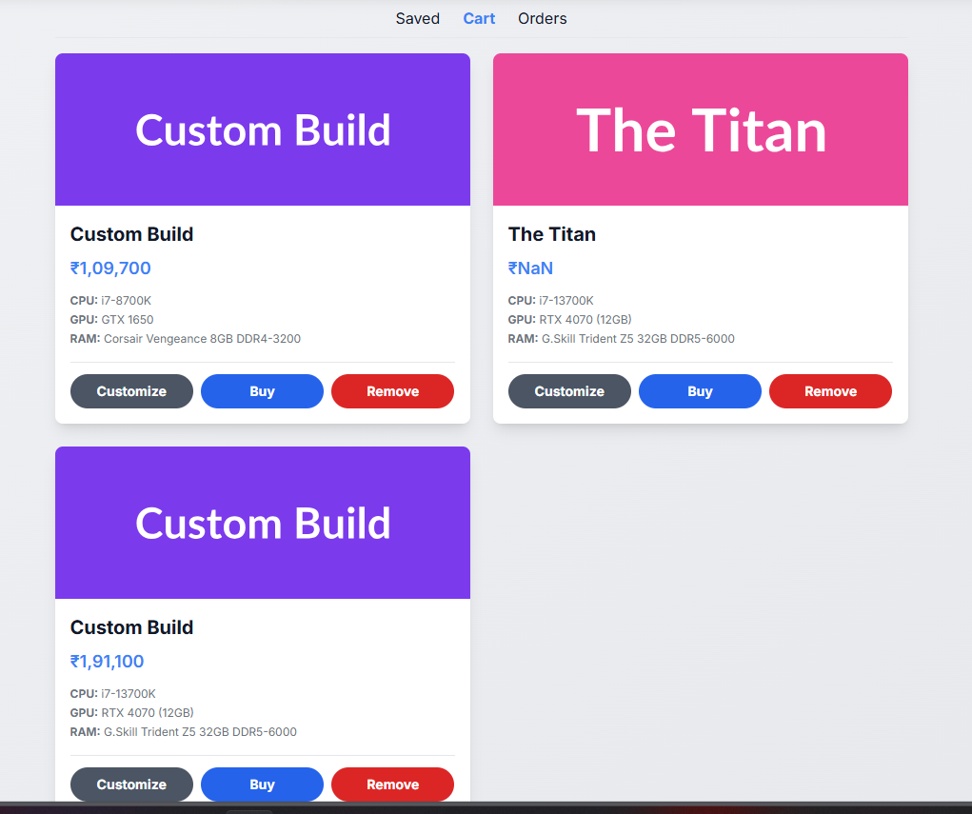
Account Page

Slide 43

About Us

Slide 44
SYSTEM TESTING
*
24- Online PCMart

Slide 45
Output Testing

Slide 46
Login Module → Correct & incorrect credentials, JWT token expiry
Registration Module → OTP verification, duplicate username/email handling
Password Reset → OTP validation, password strength check
Profile Management → Upload, update, and delete profile picture; change username
PC Builder → Component selection, total price calculation
Prebuilt PCs → Filters by usage & price working correctly
Contact Form → Successful message submission & error handling
UI/UX → Dark/Light theme toggle, smooth navigation

Slide 47
Login Success → Redirects to dashboard, returns JWT token
Login Failure → Shows “Invalid username/email or password”
OTP Sent → “OTP sent to registered email” confirmation
OTP Verified → “OTP verified, reset password now”
OTP Expired → Error message displayed
Registration Success → “User registered successfully”
Duplicate Username/Email → Error message shown
Password Reset Success → “Password reset successful”
Profile Picture Upload → Success message + image preview
Profile Picture Delete → Image removed, success message shown
Prebuilt PC Filter → Correct builds shown as per usage/price

Slide 48
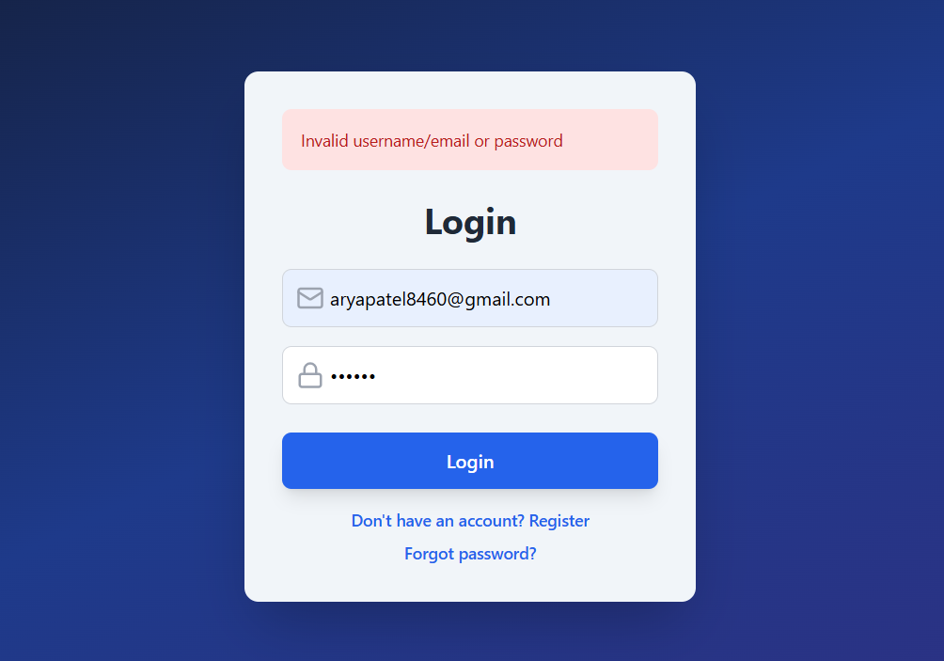
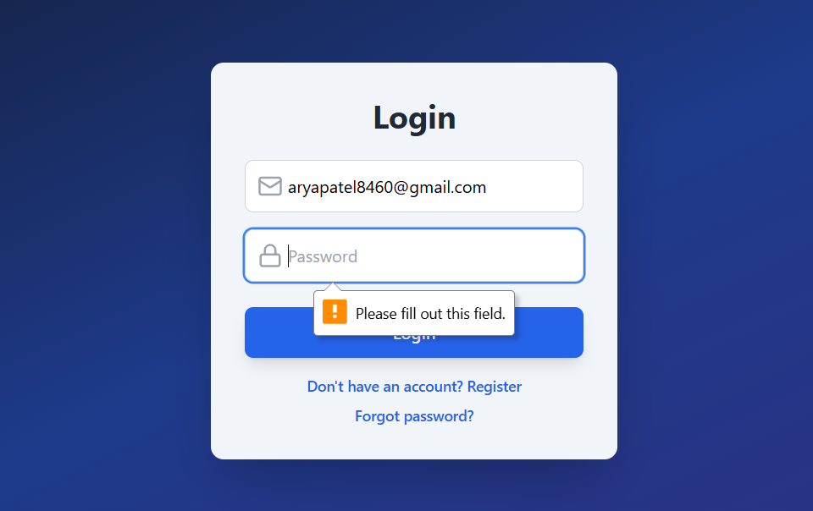
Validations

Slide 49
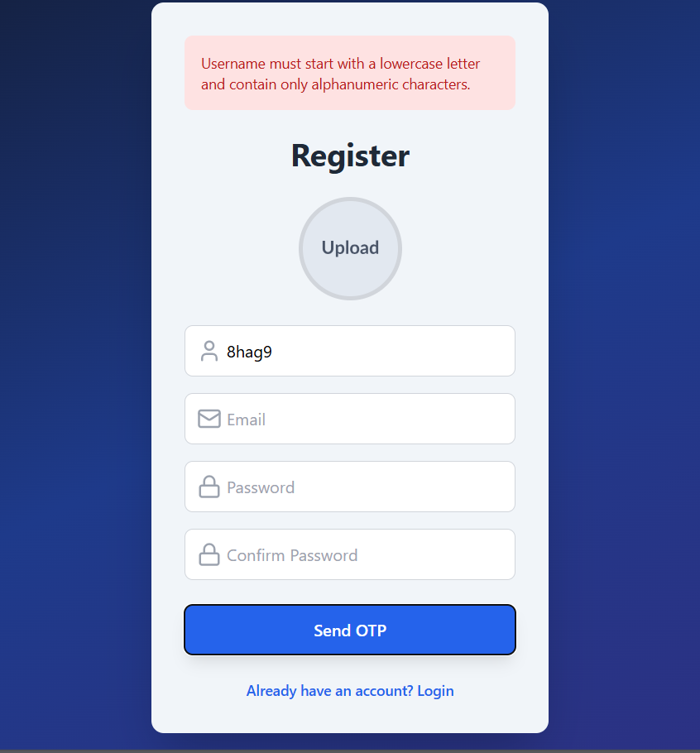
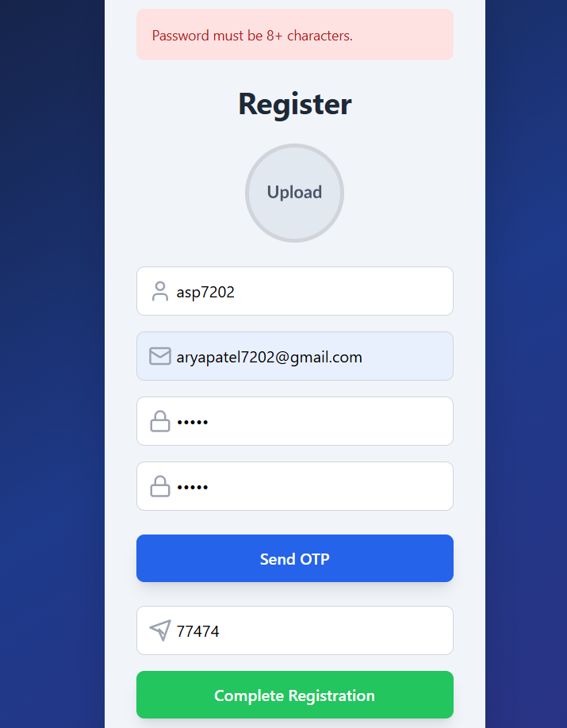

Slide 50
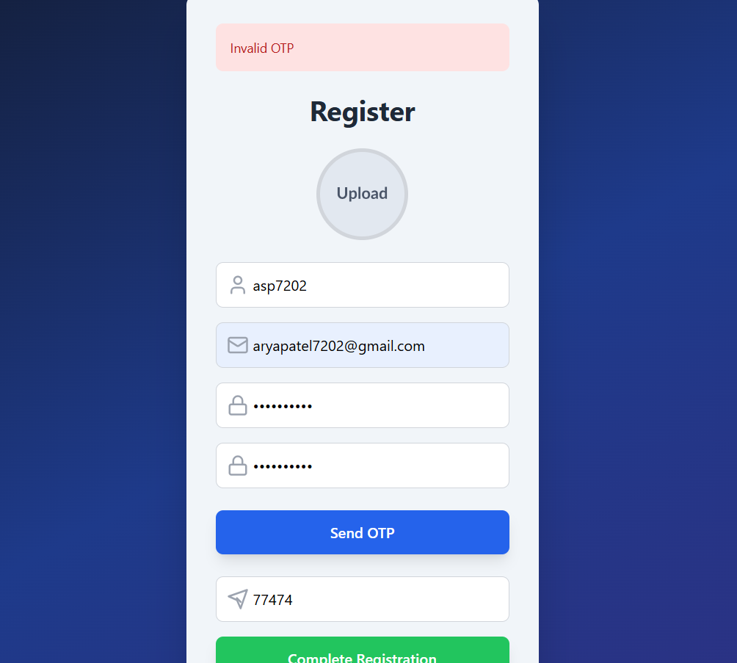

Slide 51
Forgot Password

Slide 52
Validation & Verification Testing

Slide 53
Validation Testing
Unique username & email enforced during registration
OTP ensures only verified users can register/reset password
Password rules checked (length & strength)
JWT required for accessing protected routes
PC Builder always calculates correct total price
Verification Testing
APIs tested with Postman for correct responses
Database entries verified after registration, reset, and updates
JWT expiry & renewal tested for session management
Profile picture upload/delete verified in DB & filesystem
Error messages confirmed for invalid inputs (wrong OTP, expired session, invalid email)

Slide 54
Validation Testing
Unique username & email enforced during registration
OTP ensures only verified users can register/reset password
Password rules checked (length & strength)
JWT required for accessing protected routes
PC Builder always calculates correct total price

Slide 55
Verification Testing
APIs tested with Postman for correct responses
Database entries verified after registration, reset, and updates
JWT expiry & renewal tested for session management
Profile picture upload/delete verified in DB & filesystem
Error messages confirmed for invalid inputs (wrong OTP, expired session, invalid email)

Slide 56
CONCLUSION AND FUTURE ENHANCEMENT
*
24- Online PCMart

Slide 57
Conclusion
Implemented secure authentication with JWT & OTP verification
Passwords stored safely using BCrypt encryption
Users can manage accounts → change username, upload/delete profile picture
Developed a PC Builder → select CPU, GPU, RAM, Storage, Cabinet, OS with price
calculation
Added Prebuilt PC Filtering → by usage (Gaming/Office/Dev) & price range
User-friendly frontend UI built with React + Tailwind CSS
Robust backend APIs built with Spring Boot + JPA
Integrated frontend, backend, and database into a complete full-stack system

Slide 58
Future Enhancements
AI Recommendations
->Implement AI/ML models to suggest best PC builds based on user preferences and budget.
Live Compatibility Check
->Automatically validate selected components (e.g., CPU + Motherboard compatibility).
Mobile Application
->Develop a mobile version using React Native to allow users to build PCs on the go.
Enhanced Security
->Add Two-Factor Authentication (2FA) using SMS/Email OTP or Google Authenticator.
->Implement refresh tokens for extended login sessions.

Slide 59
BIBLIOGRAPHY & REFERENCES
*
24- Online PCMart
Notes:
59

Slide 60
References

Slide 61
Books
Java: The Complete Reference – Herbert Schildt
Spring in Action – Craig Walls
React Up & Running – Stoyan Stefanov
Database System Concepts – Silberschatz, Korth, Sudarshan
Learning Web Design – Jennifer Niederst Robbins

Slide 62
Web Resources
Spring Boot → https://spring.io
Spring Data JPA → https://spring.io/projects/spring-data-jpa
JWT → https://jwt.io
React → https://react.dev
Tailwind CSS → https://tailwindcss.com
MDN Web Docs → https://developer.mozilla.org
MongoDB Docs → https://www.mongodb.com/docs
Cropper.js → https://cropperjs.com
W3Schools → https://www.w3schools.com

